Slide 1

Color adjustment
Notes:
PPT cover, add logo

Slide 2
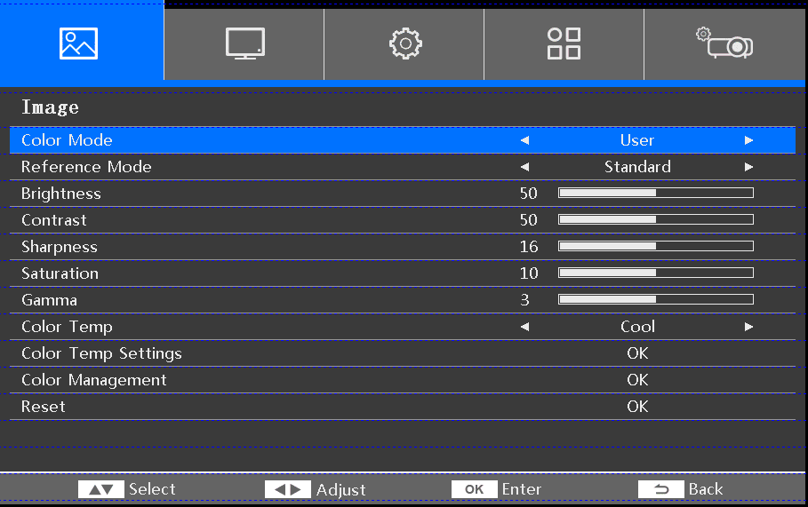
1. Adjust Project One
Step 1 : Image → Color Mode (User)/Reference Mode (Standard) → Color Management
1
2
3
4

Slide 3
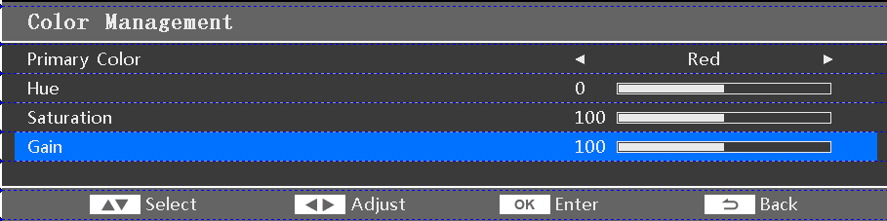
1. Adjust Project One
Step 2 : Primary Color(Red) →Gain(90~130) See the red effect within this range.
1
2

Slide 4
If that doesn't work, proceed to the second confirmation step.

Slide 5
2. Adjustment to Project Two
步骤1：Image → Color Mode (User)/Reference Mode(Standard) → Color Temp Setting
1
2
3
4

Slide 6
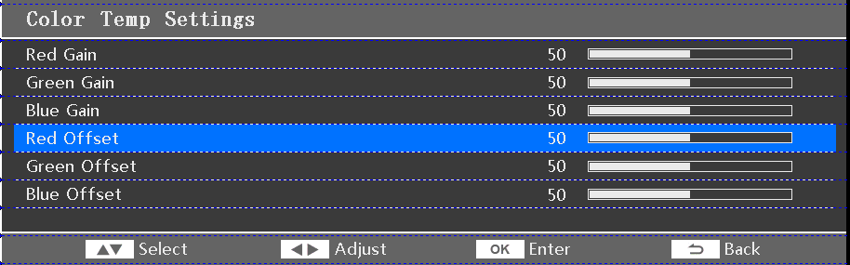
2. Adjustment to Project Two
Step 2: Red Gain (default value is 50), adjust within the range of 40~60 to see the effect.
1

